Slide 1
A Survey on Edge Computing in IoT Security
Team Members:
Rahul Agarwal (19BCE0115)
Raghav Asawa(19BCE0861)
Lava Srinivas T(18BCE0701)
Alokam Nikhitha(19BCE2555)

Slide 2
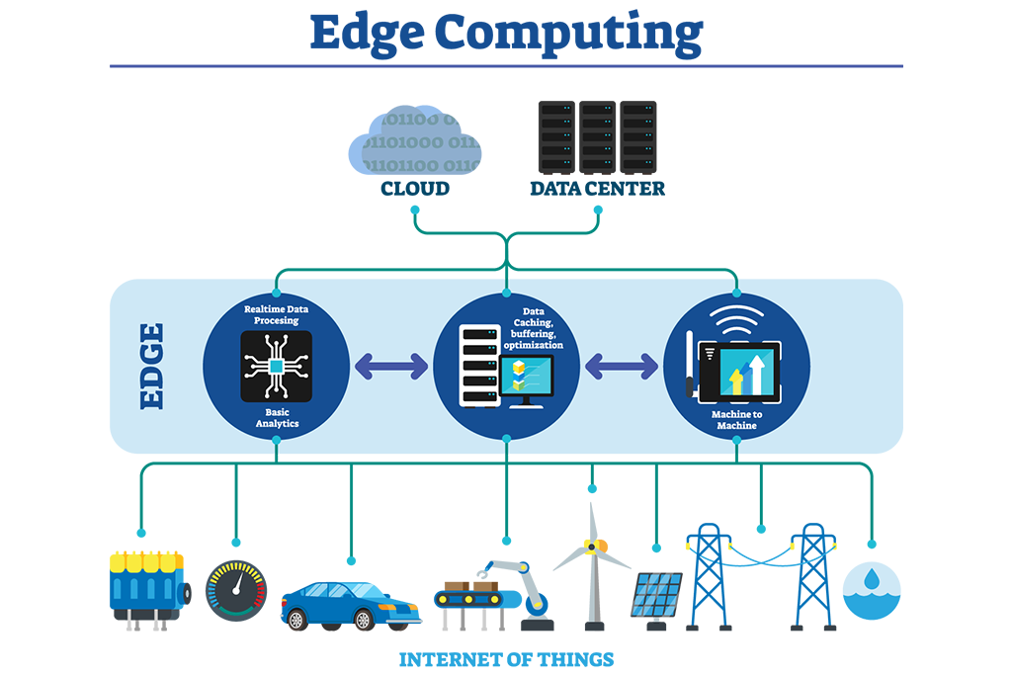
Introduction
With recent developments in sensing, communication,
and microcontroller technologies, we have been
witnessing a convergence of the physical world and
the cyber world.
Connecting billions of smart objects
and smart devices, the Internet of Things (IoT) aims to
build a smart world that enables us to perceive, analyze,
control, and optimize the traditional physical systems
using modern cyber technologies.
However, they also jeopardize the traditional physical systems with cyber threats.

Slide 3
Abstract
Our survey aims to present a comprehensive survey of existing IoT security solutions. We will present an edge-centric IoT architecture.
And we will also extensively review the edge-based IoT security research efforts within the context of security architecture design, firewalls, intrusion detection systems, authentication and authorization protocols, and privacy-preserving mechanisms.
Finally, we propose our insight into future research directions and open research issues.

Slide 4
Why we chose this topic
IoT applications enable us to perceive, analyze, control, and optimize the normal physical systems.
Recently, security breaches in many IoT applications have indicated that IoT applications may put the physical systems in danger .

Slide 5
Benefits of Edge Computing
Better data management
Lower connectivity costs
Reliable
Uninterrupted connection
Better security practices connection.
, uninterrupted connection.

Slide 6
2 major causes of the many security problems in IoT applications:
Severe resource constraints.
Insufficient security design.

Slide 7
Our Approach
Firstly,
We will present a general edge-centric IoT architecture, which explains how the edge layer interacts with the IoT application users, the cloud and the IoT end devices.
, uninterrupted connection.

Slide 8
Secondly,
A comprehensive survey of edge-based IoT security designs will be presented, and these designs are classified into five major categories, including security architecture, firewall, intrusion detection, authentication and authorization, and privacy.

Slide 9


